Slide 1
BOC 2001 Supplemental Reading
Interpreting Electric Load Data
Want to know more about energy interval data?
Check out the 2001 Supplemental Reading at the BOC website.
See the link in your notes below.
Your instructor may provide examples of energy interval data during class as time permits.
Notes:
Supplemental Reading
This material provides an overview of Interval Data and how it can be used by building operators for building scoping, energy management, and to detect equipment operation issues.
Interval data is meter data collected at defined intervals, typically every 15 minutes or hourly. It used to be that you had to install sub-meters and manage an on-site database to capture interval data. Today, the advent time-of-use rates, smart meters, and real-time communication networks means that a large and growing number of buildings have access to interval data hosted on their utility web sites.
Interval data is invaluable for managing energy consumption in your building. Interval data is energy use data that is available in time intervals less than a monthly bill. It also known as pulse or daily load data. It is collected by an interval meter, which, at the end of every interval period, records how much energy was used in the previous interval period. Access to interval data can be provided by the Utility Company if your building has an interval meter installed. It is also available using the Energy Management System to collect this data at the electric meter. If you are interested in learning more about how to access and use interval data, review the BOC 2001 Supplemental Reading material on the following pages.
Supplemental reading material is available to students registered for BOC training at this URL. Please use the password below to access it.
http://www.theboc.info/student-partner-login/boc-supplemental-class-materials/
Password: BOCstudent

Slide 2
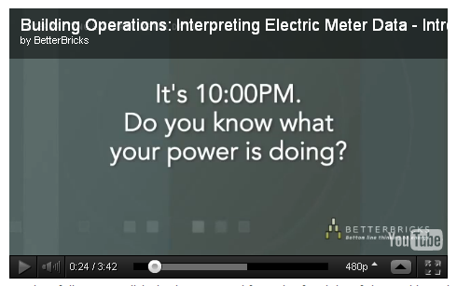
Optional Activity Load Shapes & Common Problems
Watch the video.
Discuss questions in the notes section.
http://betterbricks.com/articles/interpreting-electric-meter-data-series
Notes:
View the video “Load Shapes and Common Problems.” Break into groups. Using the sample 24-hour interval load data in the 2001 Student Handbook, take 15 minutes to answer the questions and exchange information about your professional experiences. Share your insights with the class.
Discussion Questions:
Is interval data available for your building? (Yes/No)
How could you use this type of information in your building?
What is the peak kW load during the weekday?
What do you think is the largest single electric load during this period?
What is the peak kW load during the weekend?
What is the kW load when the building is unoccupied?
What type of equipment loads occur during unoccupied hours?
What are the possible causes of the load profile between 5pm and 8pm?.
Are there any holidays during this time period?
What should a holiday load profile look like?

Slide 3
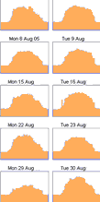
Interval Data
Daily load data
AKA pulse or interval data
Usually electric
Sometimes gas
Available from:
Utilities
Building automation system
Power monitoring
Notes:
If you are lucky enough to have access to daily utility load data, this will give you a wealth of information on the actual operation of energy consuming equipment and occupancy patterns. This will be useful for scoping as well as for diagnosis in the building tune-up. It can also be used after implementation to verify savings. The data is in the form of a rate of use, such as kW, usually averaged over the time interval. With the advent of smart meters, this information is widely available for electricity. Pulse meter data is sometimes available for natural gas in large buildings, but usually requires installation of a specialized data collector.

Slide 4
What is interval data?
Energy usage data that is time stamped in intervals
Technically, your monthly bill is interval data, but the interval is 28-33 days, depending on the month and the billing cycle.
The data is more meaningful in intervals of 1 hour or less.
15 minute interval data is probably the smallest increment you will need.
Notes:
Once you have your interval data, you can search for a software tool to use it with, unless you are very proficient in Excel. It is a good idea to check first with your utility. They may be able to supply a free software tool.
Once you have a tool to display your load shapes, you will need to know what they mean.

Slide 5
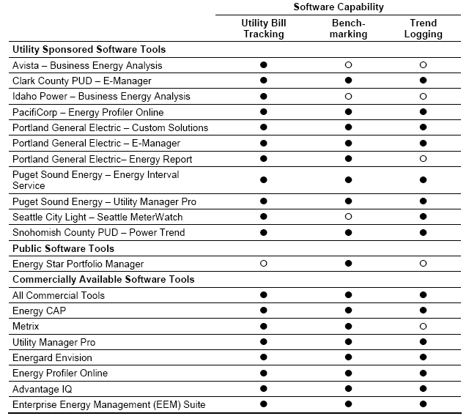
Finding a Software Tool
For updates, go to
betterbricks.com
and search for
“software tools”
Notes:
Here is a source of information for a variety of software tools for analyzing your data. Look for a tool that can handle trend logging data.

Slide 6
If You Are an Excel Wizard
Energy Charting and Metrics (ECAM) tool
Free
Facilitates the examination of utility meter data and other trended data
Data processing to attach schedule and day-type information to time-series data
Filtering by day type, day of week, time of day, occupancy, binned weather data, month or year, pre/post, equipment status
Normalization of data based on user-entered information
Creation of a variety of load profile and x-y charts for the points selected by the user
http://www.cacx.org/resources/rcxtools/spreadsheet_tools.html
Notes:
For those of you proficient in Excel, this is a free tool you may want to use to help organize and analyze raw data. The Energy Charting and Metrics (ECAM) tool is installed as an Excel add-in.
The user’s original data is not modified in the process of using the tool, but is copied into a new workbook automatically. The tool makes extensive use of Excel pivot tables to facilitate summarization and filtering of the data. It goes beyond normal pivot tables and pivot charts, however, by automating the creation of scatter charts based on pivot table data.
This website of the California Commissioning Collaborative has a number of other useful tools, including energy savings calculators for various commonly found operational improvements.

Slide 7
What can it tell you?
Interval load data can answer questions like:
Does the load profile match operating hours and occupancy?
Are HVAC system timers programmed correctly?
When does the building use the most energy?
Is the base load normal for this facility?
When did something change to cause a 15% increase in load?
How does weather affect operations?
Can peak or base load be reduced?
Did my energy improvement save energy?
Notes:
Most of the time, you will be looking at interval data for a day, week, or month at the most; otherwise, details will be obscured. The best use of the data is to take a close look at daily operation. For annual estimates and seasonal trends, monthly utility data is still the best choice.
Normal use is different for every facility, but for a typical office you can expect to see equipment coming on an hour or two before occupancy to bring the building up to comfort conditions and ramping up to full use. The time of the actual peak can vary by season, but is most often at the beginning of full occupancy or late afternoon when solar loads can cause a spike in cooling. The load should drop to base level after occupied hours; how quickly it tapers off is influenced by cleaning crew work patterns or, if it is a mixed use building, some tenants may keep longer hours.
As a general rule, the base load should be no more than 20% of the peak load.

Slide 8
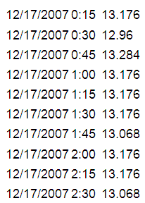
Some things to watch for
Time stamp, what is marking the time?
What is setting the time stamping clock?
What is the time?
What are the units (kW, kWh)?
Is there a multiplier?
Notes:
Before analyzing your interval data, you need to know a number of things about the data.
Some things to watch for:
Time stamp, what is marking the time?
What is setting the time stamping clock? (computers tend to drift unless corrected)
Is the time in UT, local time, daylight saving time?
What happens when the time changes? Does it change or not?
If comparing to equipment run/stop times what is setting time for those?
Is there data backup?
Archiving—how long is it kept? Does it get written over after a certain period of time?
What are the units (kW, kWh)? Is it the average value of the demand readings for the time period or kWh used?
If demand, are these values instantaneous or averages values?
Is there a multiplier? Current transformers or potential transformers are sometimes used to reduce the actual values to something that can be measured less expensively. These will need a multiplier.

Slide 9
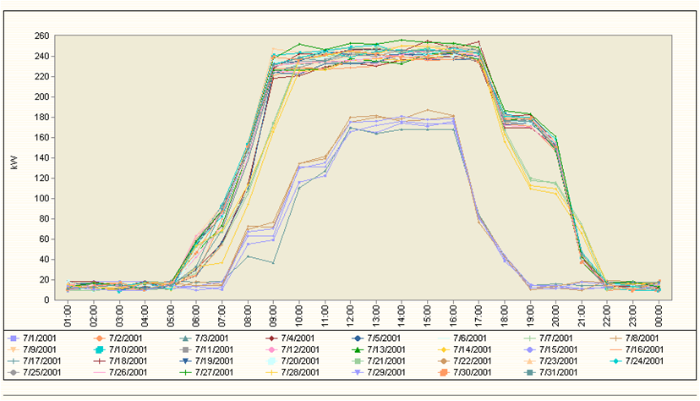
24-Hour Line Chart
Weekdays
Weekends
Notes:
Whatever software you use, a graph like this is very useful. This one shows all the days in the month of July.
This has the hours of the day on the bottom axis and the kW demand on the left axis.
At first glance, there are many lines, and it is hard to make sense of them all.
But you can see some patterns.
Weekdays
Weekends
Notice the different start times
Notice the weekend profiles. Is someone there on weekends, and just the HVAC coming on without the lights?
Why did a few days shut down earlier than other days? In this case, it was found that the cleaning crew doesn’t work on Fridays. The crew cleans on Sunday.

Slide 10
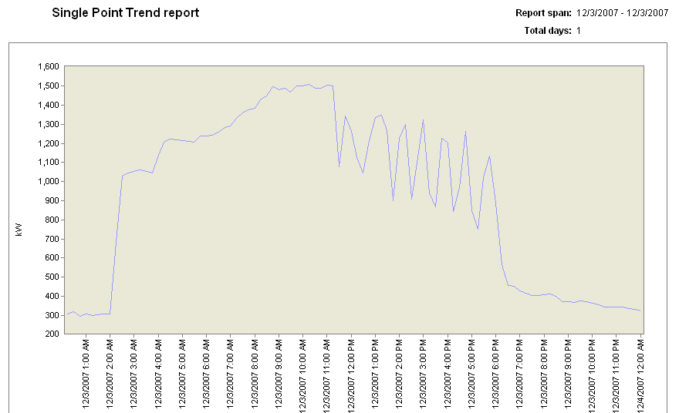
Single Point Trend
400 kW cycling load
Notes:
This is an example of a single point trend. It shows one meter for one day.
Some things to notice here are the very early system start-up at 2 a.m. and a 400 kW load that is cycling in the afternoon.

Slide 11
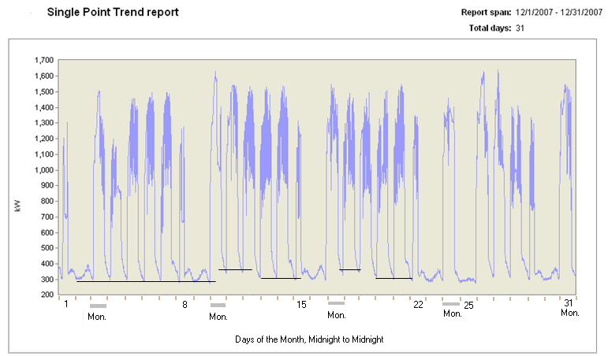
Single Point Trend
Notes:
Other patterns may become evident when the single point trend is extended over a period of days, in this case one month.
You can see fluctuations in the base load.
Something is cycling, which acts differently on different days.

Slide 12
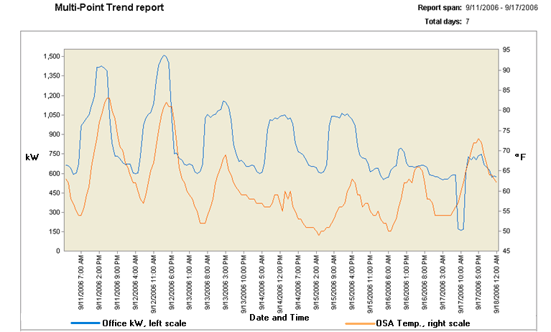
Multi-Point Trend
Notes:
With a multi-point trend, you can overlay different meters:
Additional meters on the same building
Different buildings
Other parameters, such as weather or gas data
In this case, the kW load, and outside air temperature (OSA) are the trends.
What do you observe on this trend?
Possible answers:
Occupied use profile tracks with weather.
Base use (unoccupied) does not seem to be affected by weather.
Base use is a very high percentage of peak use—check equipment schedules.
It would be interesting to know what went off-line Sunday morning.
kW load
OSA

Slide 13
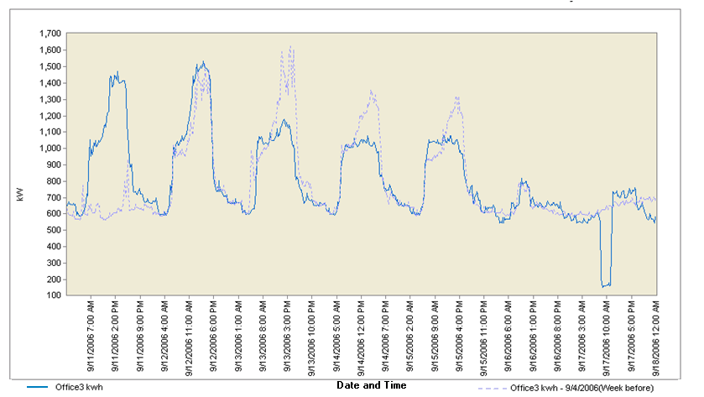
Single Point Trend
Overlay other dates
Notes:
In this graph, two consecutive weeks are shown together. You can see that the first two days of each week have higher peaks than the rest of the week, even though in one of the weeks, the first occupied day was a Tuesday. If this pattern continues, it would be worth investigating.

Slide 14
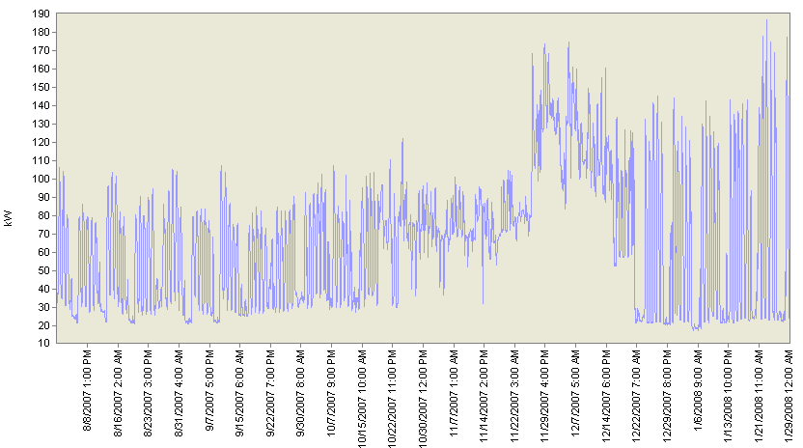
Reviewing the Interval Data
High bill complaint
30% increase in bill
One Week
October 15th
Installed a new HVAC System
Next bill was 44% higher, totaling a 90% bill increase
Notes:
In this case, the interval data was used to evaluate a high bill complaint. It is obvious from the chart that the installation of a new HVAC system was the culprit. The base load immediately increased. The following week, both the peak and base loads increased dramatically. Adjustments were evidently made to schedule off during unoccupied hours, but the base use remained high during occupied hours. Information was not available as to the final resolution. The time period goes from August through December, where it appears to be trending even higher. One place to look might be the economizer operation. It could be inoperable or stuck in an open position. If the new system were a heat pump, it might explain some higher use in the colder months since it would be a little less efficient, but the next place to look would be the changeover temperature to go to the back-up electric resistance heat.
High bill complaint
30% increase in bill
Next bill was 44% higher, totaling a 90% bill increase
October 15th
Installed a new HVAC System
One Week

Slide 15
Typical Problems Identified
Early morning startup too soon
Evening shut down slow or late
Weekend or holiday schedules incorrect
Equipment starting and stopping when no one is around.
Controls programmed wrong
Equipment failures

Slide 16
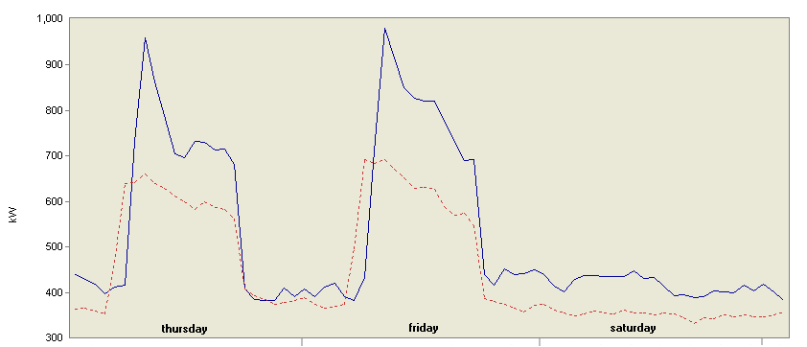
Controls Reprogramming Error
Before After
Controls programming error caught with interval data
Notes:
In an effort to decrease the building start up demand, the controls were reprogrammed.
Notice, the before is in the orange and the after is the blue. The programming change did not have the desired effect. This problem was caught right away, because the building had interval data.

Slide 17
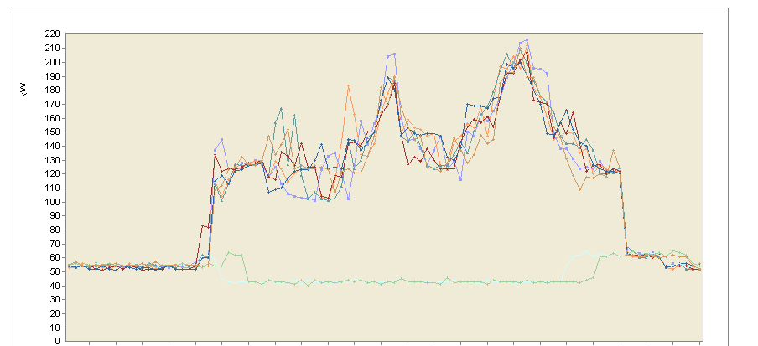
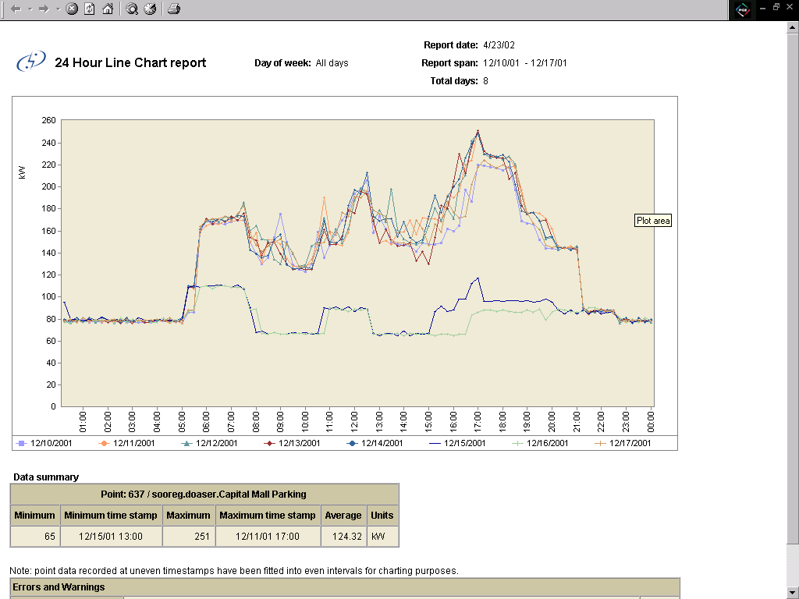
Parking Garage Time Clock Failure
Time clock failure
caused unit to run
Normal weekend load
Notes:
These charts each show a week of monitoring of power to a parking garage. The days are superimposed with hourly tick marks on the X axis from midnight to midnight. The upper weekday shapes are as expected, showing that the exhaust fan has morning, lunchtime and evening high use periods. The weekend load should be flat, as it is in the upper chart. The lower chart shows a fan operating when it should have been disabled. If the fan is triggered by levels of carbon monoxide, another conclusion might be that there is enough weekend use to regularly enable it. It certainly warrants additional investigation.

Slide 18
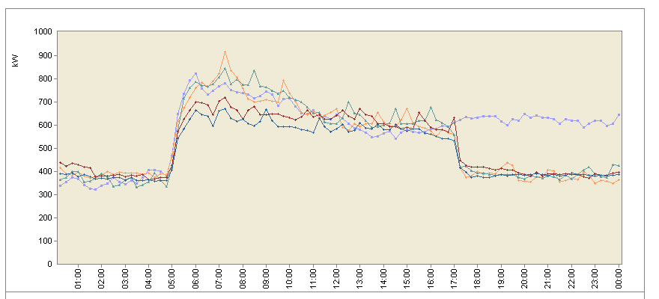
Controller Failed in Occupied Mode
Power Interruption by contractor caused controller to fail in Occupied Mode
Notes:
In this case, a controller normally shuts down equipment at 5 p.m., but because of some contractor work that caused a power failure, a controller failed in the occupied mode and prevented the equipment from shutting down.
Not only did the customer have the contractor repair the damaged equipment, they charged them for the extra electricity used because of the problem.

Slide 19
Activity – Draw Your Own Load Shape
Given:
A medium-sized office building, 100,000 sqft.
Normal occupancy 8-5, Monday-Friday, 9-1 Saturday.
Two air-cooled chillers, gas boiler, VAV with electric reheat.
Typical office use.
Based on the given information:
Draw the expected load shape for a typical summer Wednesday.
On the same chart, draw the expected load shape for a typical weekend day or holiday.
Notes:
In Appendix E-1, you have a blank chart. The horizontal axis represents the 24 hours in a day. The vertical axis is kW of electric load. For the building described, which corresponds to our ACME Office building, sketch out what you think the load shape would look like on a typical Wednesday in the middle of summer. On the same chart, draw what you think the load shape would look like on an unoccupied weekend day or holiday. Take a guess at the magnitude of the peak, but think more about the overall shape, taking into account the occupied hours.

Slide 20
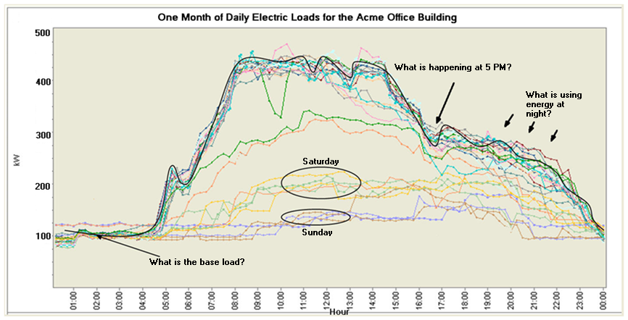
Activity ACME Office Interval Chart
Notes:
In this chart, you see a representation of actual data for this building.
Compare it to the chart you drew and answer these questions:
What is the base load?
Does the weekend use look okay?
What is happening at 5 p.m.?
Where would you look for energy savings?
How much energy would be saved by reducing evening use to base level?

